Slide 1

Chapter 3 ~ Spatial and Intensity Transformation
Heaven’s Light is Our Guide
Department of Computer Science & Engineering
Rajshahi University of Engineering & Technology, Rajshahi-6204, Bangladesh.
S. M. Mahedy Hasan
Assistant Professor, Dept. of CSE
RUET, Rajshahi-6204, Bangladesh.

Slide 2
Image Quality Factors
To improve the quality of an image, it is necessary to access it’s quality.
This requires some quality quantification and assessment tools.
Image enhancement can be understood with the concept of image quality.
Several factors are responsible for image quality but essential factors are:
Contrast
Brightness
Spatial Resolution
Noise

Slide 3
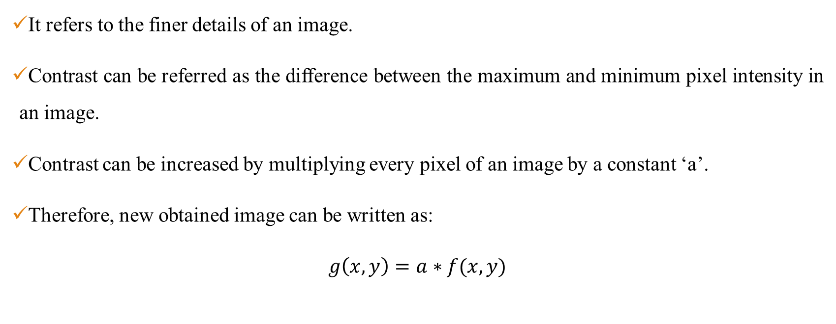
Contrast

Slide 4
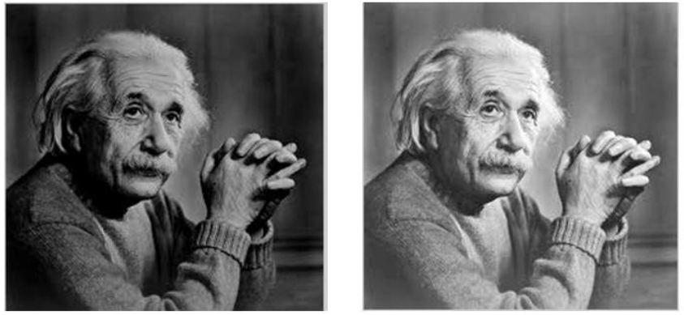
Brightness
Brightness is a relative term. It depends on your visual perception.
Brightness refers to the average pixel intensities of an image.
Brightness can be simply increased or decreased by simple addition or subtraction, to the image matrix.
Figure 1: Low brightness vs high brightness image

Slide 5
Spatial Resolution
Spatial resolution is a term that refers to the number of pixels or pixel density in per unit distance.
This depends on sampling and quantization process.
If spatial resolution is not satisfactory, then the image quality not be satisfactory.
Images with higher spatial resolution are composed with a greater number of pixels than those of lower spatial resolution.

Slide 6
Spatial Resolution (Cont’d)
Since, the spatial resolution refers to clarity, so for different devices, different measure has been made to measure it.
Some of the examples are:
Dots per inch (usually used in printers/Monitors)
Lines per inch (usually used in laser printers)
Pixels per inch (Usually used in monitors)

Slide 7
Noise
Noise is an unwanted disturbance that causes the fluctuations in the pixel value.
It is a random or stochastic process, therefore, it’s true value can not be predicted accurately.
Noise obeys all the statistical properties.

Slide 8
Image Processing
Sometimes, it is very difficult to extract the complete information from a image due to it’s poor quality.
In order to extract complete information from that image, we have to process that image.
To enhance the particular image, we have to go for image processing operations.
Principally, there are two types of image processing domains:
Spatial Domain
Frequency Domain

Slide 9
Spatial Domain
Spatial domain deals with image plane itself.
Whenever, we represent an image as f(x, y), here, the (x, y) represents the spatial location of that image.
Here, we directly manipulate and single pixel in the spatial domain.
y
Origin
Origin
Pixel
x

Slide 10
Frequency Domain
Spatial Domain Image
Fourier Transform Domain
Inverse Fourier Transform Domain
Spatial Domain Image
At first, we convert the spatial domain image to transform domain image.
The transform domain is Fourier transform and here, we use some processing on Fourier transform domain image.
After performing some processing operations we convert the Fourier transform image into inverse Fourier transform domain to bring to the results in spatial domain.

Slide 11
Spatial Domain vs Frequency Domain
It is very easier to process images in spatial domain compared to frequency domain.
Efficiency is very high in spatial domain compared to frequency domain.
Generally, spatial domain techniques are more efficient computationally and require less processing resources to implement.

Slide 12
Spatial Domain
In spatial domain, there are two types of transformations:
1. Intensity Transformation (Point Processing): We directly manipulate each and every single pixel and transform this pixel or output of this transformation results with the new intensity value of this pixel. It deals with contrast manipulation and image thresholding.
2. Spatial Filtering (Neighborhood Processing): It deals with performing operations, such as image sharpening, by working in a neighborhood of every pixel in an image.

Slide 13
Point Processing
The smallest possible neighborhood is of size 1x1. In this case,
‘g’ depends only on the value of f at a single point (x, y).
‘T’ becomes an intensity transformation function (also called gray-level or mapping transformation function).
s → The intensity of g at any point (x, y)
r → The intensity of f at any point (x, y)

Slide 14
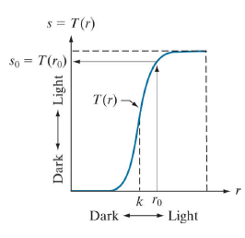
Point Processing (Contrast Stretching)
Produce an image of higher contrast than the original by
Darkening the intensity levels below ‘k’ and Brightening the intensity levels above ‘k’.
This technique is called contrast stretching. Here, values of ‘s’ lower than ‘k’ are mapped to the narrow range of ‘s’, toward black or darker region.
For values of r higher than ‘k’ are mapped to the narrow range of ‘s’ towards the brighter region.
Figure 3: Contrast Stretching

Slide 15
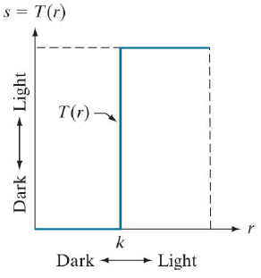
Point Processing (Thresholding)
It Produces a two-level (binary) image and thresholding is done based on the intensity value of ‘K’.
If the value of ‘r’ lies between 0 to K it is assigned 0 (black) and if the value of r greater than K then it is assigned 1 (white).
Figure 4: Image Thresholding

Slide 16
Point Processing (Thresholding)
Example 1: Consider the following image and perform image thresholding operation for k=4,
4 | 3 | 5 | 2
3 | 6 | 4 | 6
2 | 2 | 6 | 5
7 | 6 | 4 | 1

Slide 17
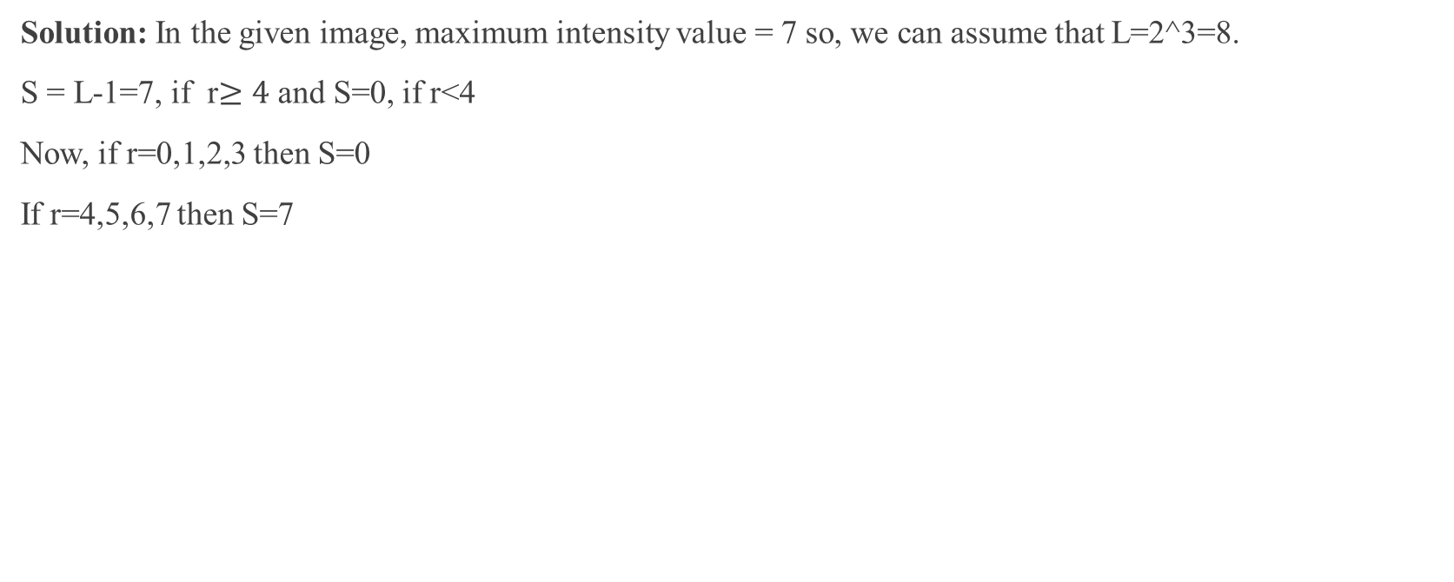
Point Processing (Thresholding)
Output Image
7 | 0 | 7 | 0
0 | 7 | 7 | 7
0 | 0 | 7 | 7
7 | 7 | 7 | 0

Slide 18
The Basics of Intensity Transformations and Spatial Filtering
Neighborhood Processing
The spatial domain processes can be denoted by the expression:
f(x, y) → The input image
g(x, y) →The output image, and
T → An operator on f(x, y) defined over a neighborhood of point (x, y)

Slide 19
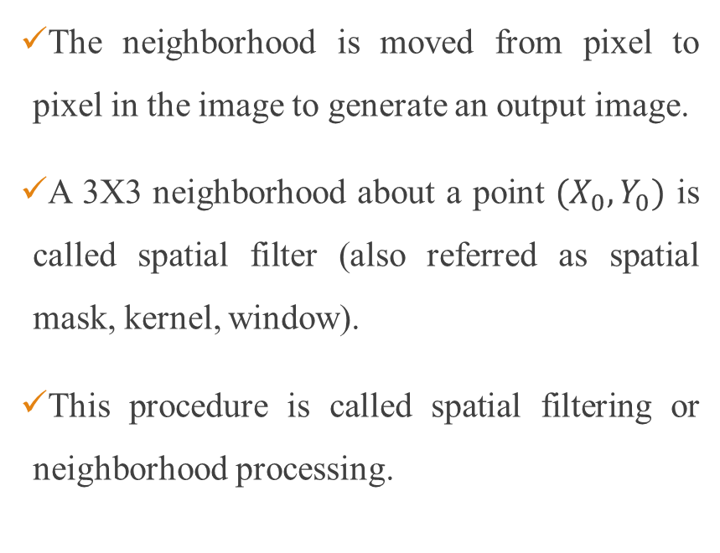
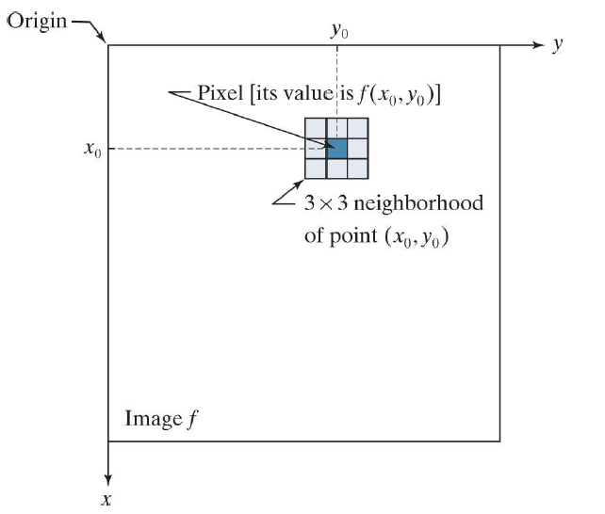
Neighborhood Processing
Figure 2: A 3x3 neighborhood about a point in an image.

Slide 20
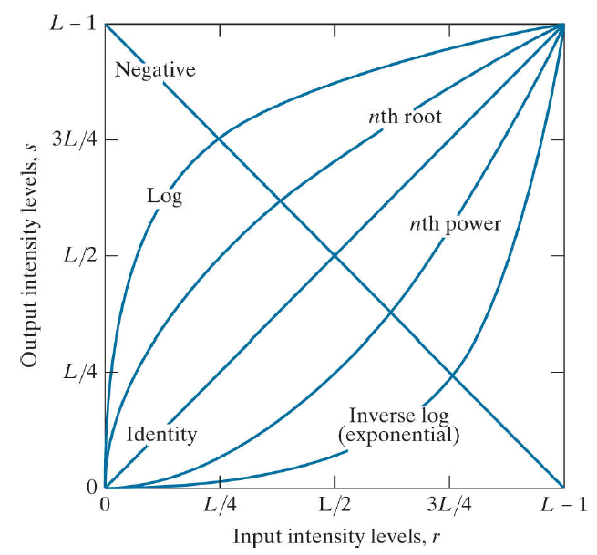
Some Basic Intensity Transformation Functions
There are three intensity transformation functions:
Linear (Negative and Identity Transformation)
Logarithmic (Log and Inverse Log Transformation)
Power Law or Gamma Correction (Transformation)
Figure 5: Basic Intensity Functions

Slide 21
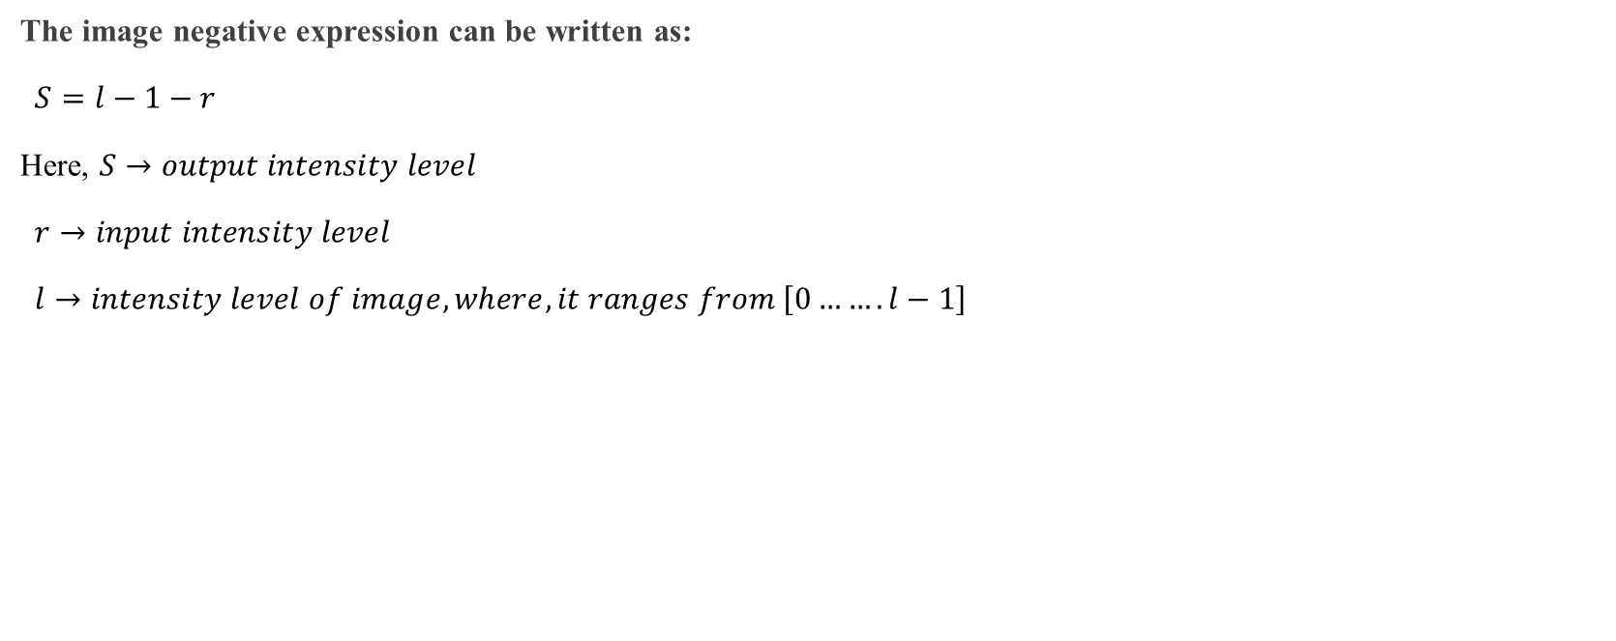
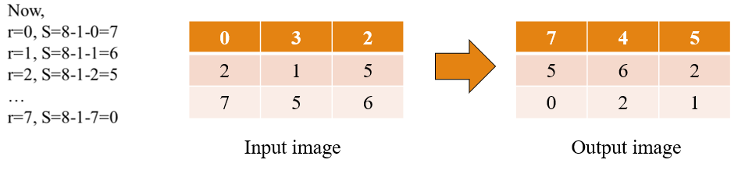
Linear (Negative and Identity Transformation)

Slide 22
Linear (Negative and Identity Transformation)
Image Negatives: Enhance white or gray detail embedded in dark regions of an image, especially when the black areas are dominant in size.
s
7
6
5
4
3
2
1
0
0 | 1 | 2 | 3 | 4 | 5 | 6 | 7 | r

Slide 23
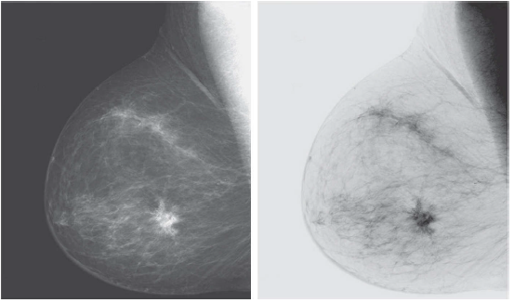
Image Negatives
Original Digital Mammogram
Negative Image
Figure 6: Breast Tissue Analysis Using Mammogram Image

Slide 24
Logarithmic Transformation (Log and Inverse Log)
The log transformation is another type of image enhancement technique that is used to adjust the brightness and contrast of an image.
The log transformation maps the pixel values of an image to their logarithmic values, which compresses the dynamic range of the pixel values and enhances the details in the darker areas of the image.
In the log transformation, brighter pixels are compressed or reduced in brightness, while darker pixels are expanded or increased in brightness.

Slide 25
Logarithmic Transformation (Log and Inverse Log)
In log transformation, the darker pixels are mapped to a higher range of output pixel values while the brighter pixels are mapped to a lower range of output pixel values.
Specifically, the log transformation has the effect of reducing the contrast of bright regions of the image while enhancing the contrast of dark regions of the image.
This is because the log function has a slower rate of increase for higher input pixel values compared to lower input pixel values.
As a result, the transformation will "stretch out" the lower pixel values while "compressing" the higher pixel values.

Slide 26
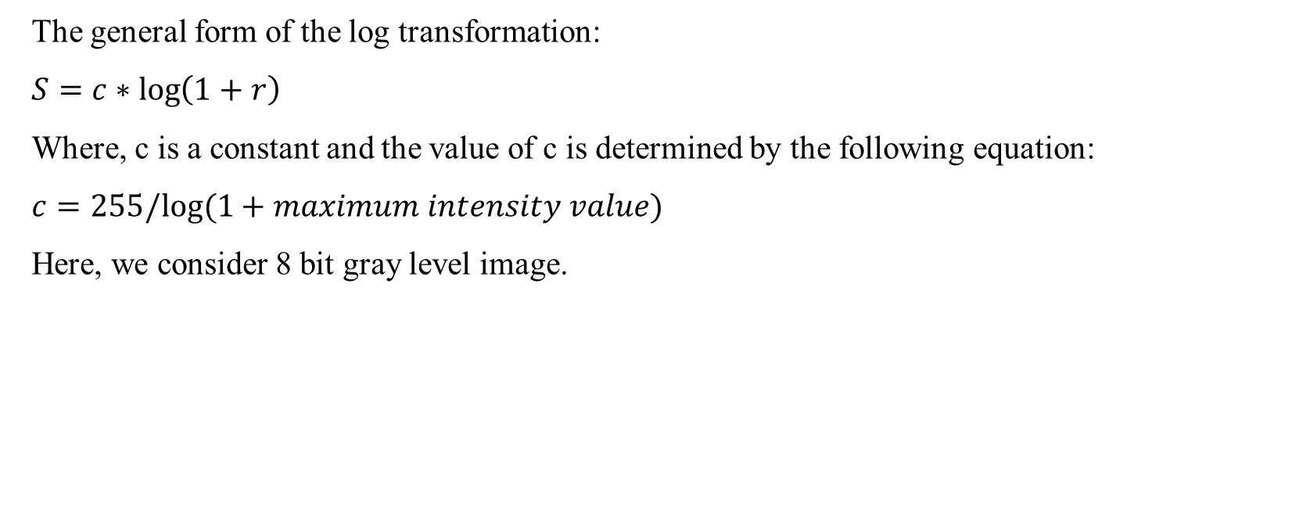
Logarithmic Transformation (Log and Inverse Log)

Slide 27
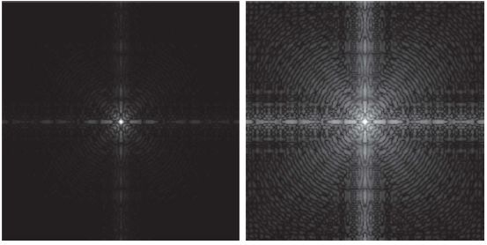
Logarithmic Transformation (Log and Inverse Log)
(a)
(b)
Figure 7: (a) Fourier spectrum displayed as a grayscale image and (b) Result of applying the log transformation

Slide 28
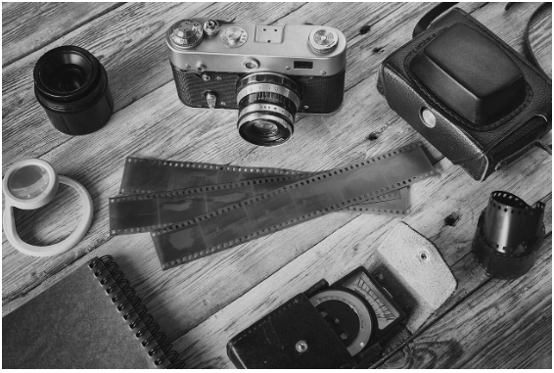
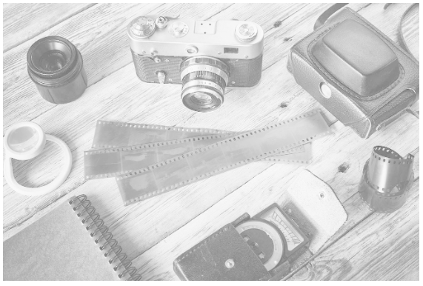
Logarithmic Transformation (Log and Inverse Log)
(a)
(b)
Figure 8: (a) Original image and (b) Result of applying the log transformation

Slide 29
Uses of Logarithmic Transformation (Log and Inverse Log)
When the dynamic range of the image is greater than that of the displaying device, the lower values are suppressed.
To overcome this issue, we use log transform.
Log transformation first compresses the dynamic range and then upscale the image to a dynamic range of the display device.
In this way lower values are enhanced and thus the image shows significantly more details.
Logarithmic transformation is appropriate when we want to enhance the low pixel values at the expense of loss of information in the high pixel values.

Slide 30
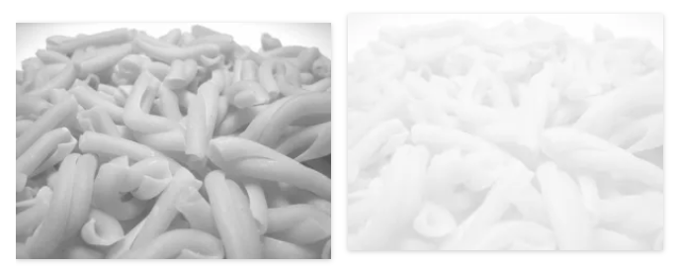
Uses of Logarithmic Transformation (Log and Inverse Log)
If most of the details are present in the high pixel values, then applying the log transformation results in the loss of information is shown below.
Original image
Log transformation

Slide 31
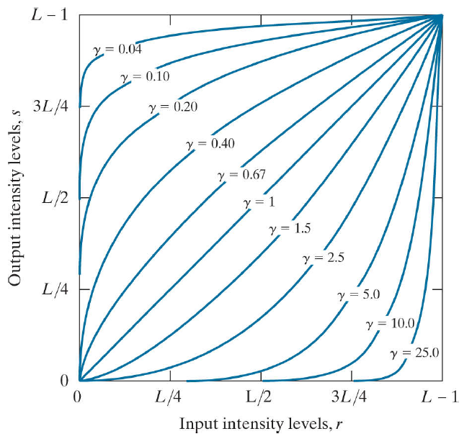
Power-Law or Gamma Correction (Transformation)
In gamma correction, the darker pixels are typically brightened, while the brighter pixels are darkened.
The extent of this brightening or darkening depends on the gamma value used.
For gamma values less than 1, which is typical of most digital images, the darker pixels are brightened more than the brighter pixels, resulting in an overall increase in contrast.
Conversely, for gamma values greater than 1, the brighter pixels are darkened more than the darker pixels, resulting in an overall decrease in contrast.
Figure 9: Power law curve

Slide 32
Power-Law or Gamma Correction (Transformation)
When the gamma values are higher than 1, it causes the darker regions of the image to become even darker, while the brighter regions become less bright.
As a result, the image may appear to have lower contrast and overall darker.
When the gamma values are less than 1, it causes the brighter regions of the image to become even brighter, while the darker regions become less dark/brighter.
As a result, the image may appear to have higher contrast and overall brighter.

Slide 33
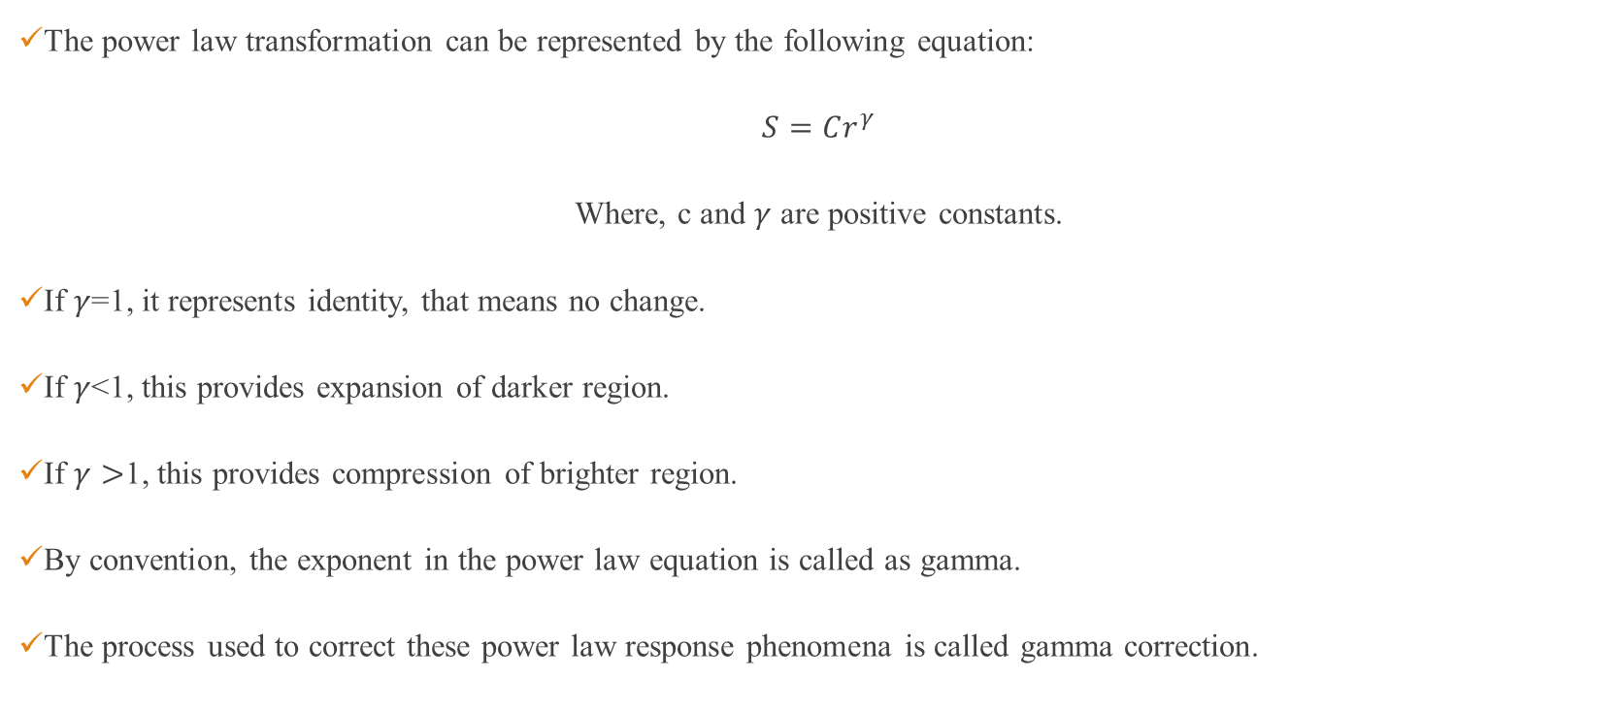
Power Law or Gamma Correction (Transformation)

Slide 34
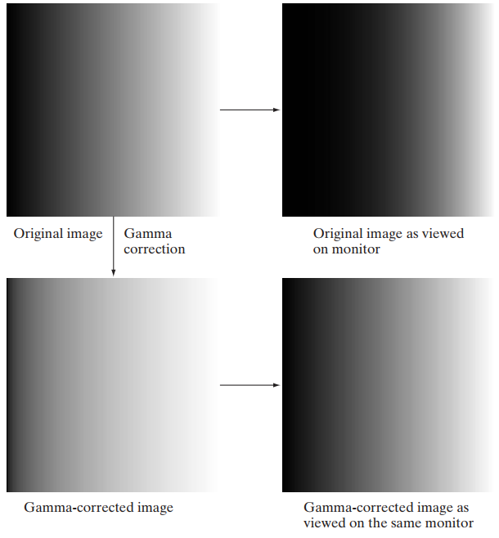
Power-Law or Gamma Correction (Transformation)
Figure 10: Effect of gamma correction

Slide 35
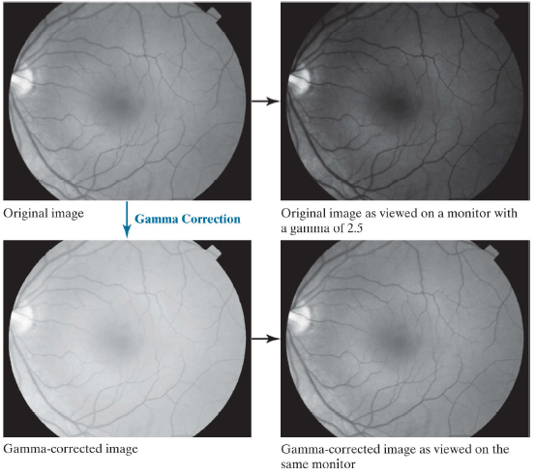
Power-Law or Gamma Correction (Transformation)
Figure 11: Effect of gamma correction

Slide 36
Power-Law or Gamma Correction (Transformation)
Important Notes: Sometimes, a higher gamma makes the displayed image look better to viewers than the original because of an increase in contrast. However, the objective of gamma correction is to produce a faithful display of an input image.

Slide 37
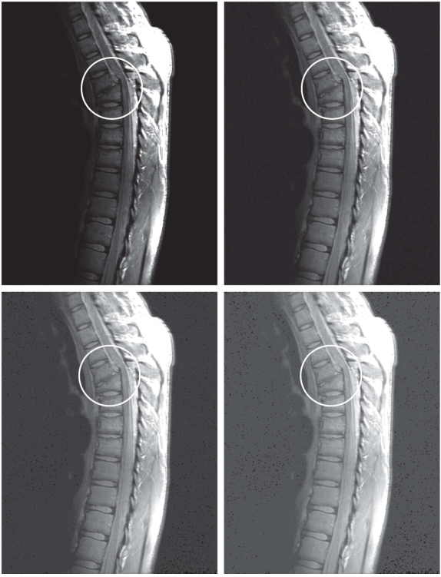
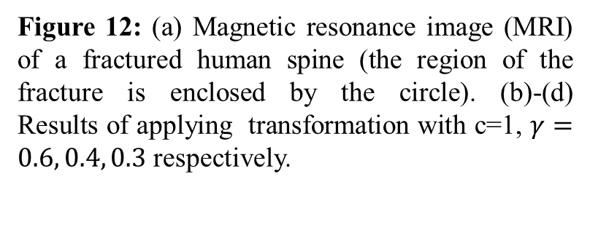
Power-Law or Gamma Correction (Transformation)

Slide 38
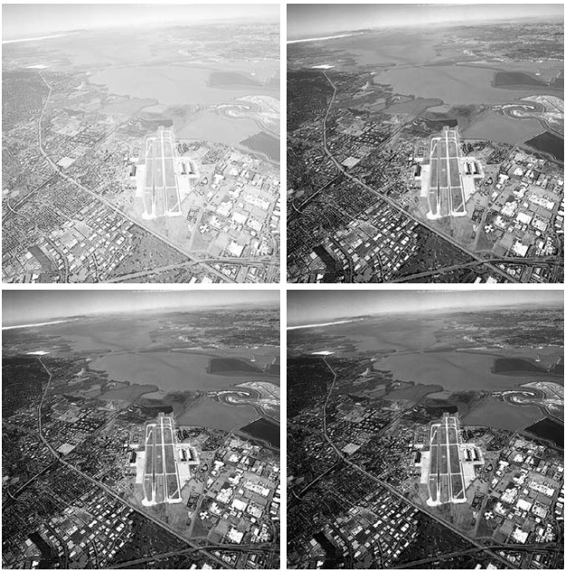
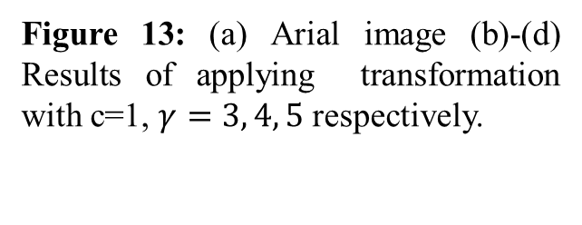
Power-Law or Gamma Correction (Transformation)

Slide 39
Piecewise Linear Transformation Functions
In piecewise linear transformation, we have three different applications:
Contrast stretching
Intensity Level Slicing
Bit - Plane Slicing

Slide 40
Contrast Stretching
Whenever, we capture an image, sometimes, we get low quality image.
Due to the restrictions in the dynamic range in the sensing elements of the imaging system we used.
Sometimes, due to very poor illumination while capturing the image.
Due to wrong fixing of lens aperture in the digital cameras or the imaging system which we used to capture the image.
This low contrast images should be enhanced and to improve the quality of the low contrast image, we use contrast stretching.
Contrast stretching is a technique used to stretch the histogram of an image so that the full dynamic range of the image is filled.

Slide 41
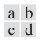
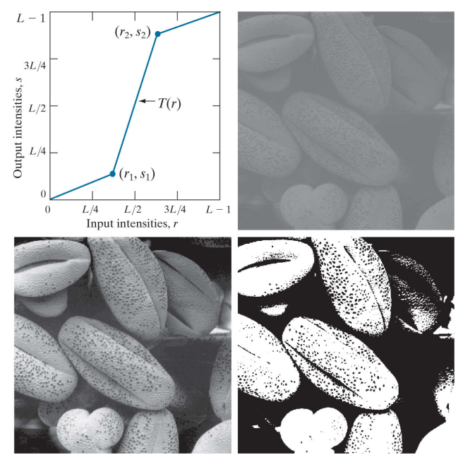
Contrast Stretching
Figure 14: Contrast stretching. (a) Piecewise linear transformation function. (b) A low-contrast electron microscope image of pollen, magnified 700 times. (c) Result of contrast stretching. (d) Result of thresholding.

Slide 42
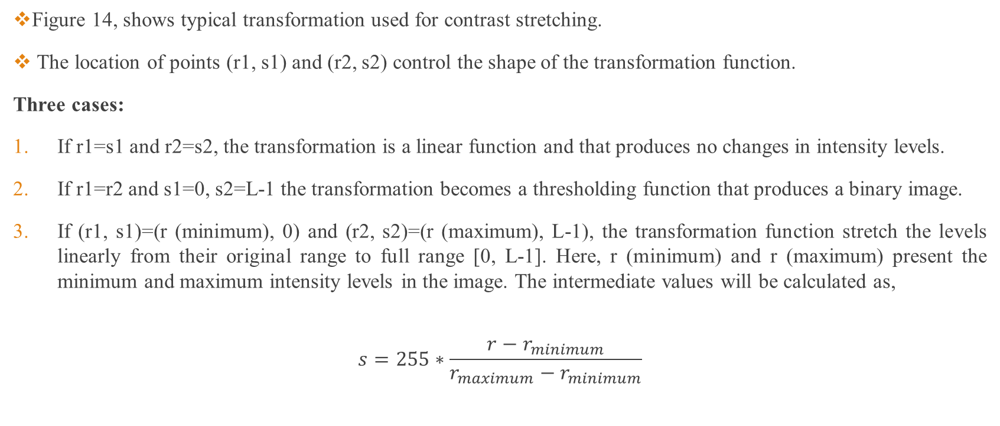
Contrast Stretching

Slide 43
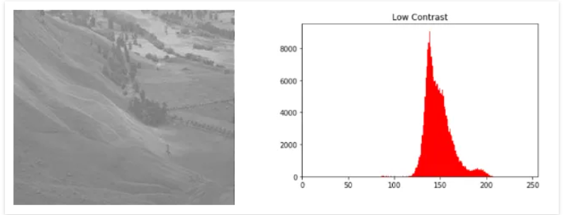
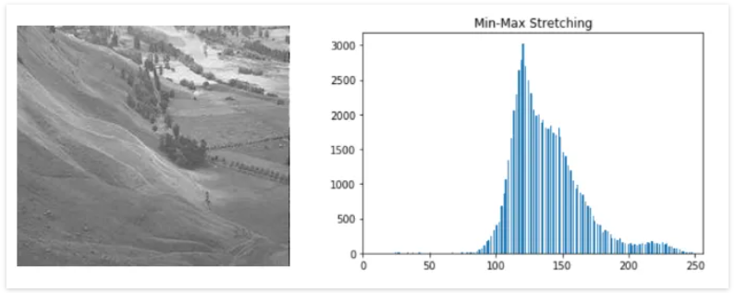
Contrast Stretching
Figure 15: Original image vs Min-Max contrast stretched image

Slide 44
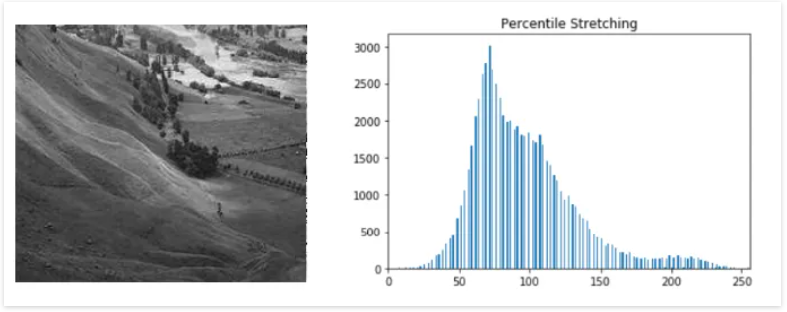
Contrast Stretching
If (r1, s1)=(r (minimum) + C, 0) and (r2, s2)=(r (maximum) - C, L-1), the transformation function stretch the levels linearly from their original range to full range [0, L-1]. Here, r (minimum) and r (maximum) present the minimum and maximum intensity levels in the image.
Figure 15: Original image vs Percentile contrast stretched image

Slide 45
Intensity Level Slicing
Here, we highlight only a particular range of intensity levels which is of interest in the image.
This is used in medical applications, in X-ray images, in order to enhance only the flaws in the X-ray images.
This can also be used in satellite imagery, such as masses of water or need to highlights water bodies present in that image.
The method, called intensity level slicing, can be implemented in several ways, but most are variations of two basic themes.

Slide 46
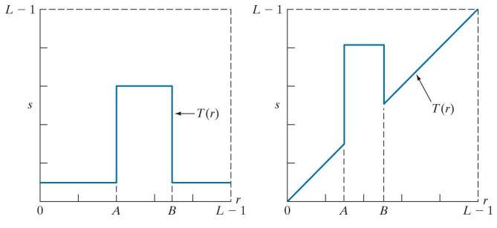
Intensity Level Slicing
One approach is to display in one value (say, white) all the values in the range of interest and in another (say, black) all other intensities.
This transformation, shown in Fig 15(a) , produces a binary image.
The second approach, based on the transformation in Figure 15(b) , brightens (or darkens) the desired range of intensities, but leaves all other intensity levels in the image unchanged.
Figure 15: (a) This transformation function highlights range [A, B] and reduces all other intensities to a lower level. (b) This function highlights range [A, B] and leaves other intensities unchanged.

Slide 47
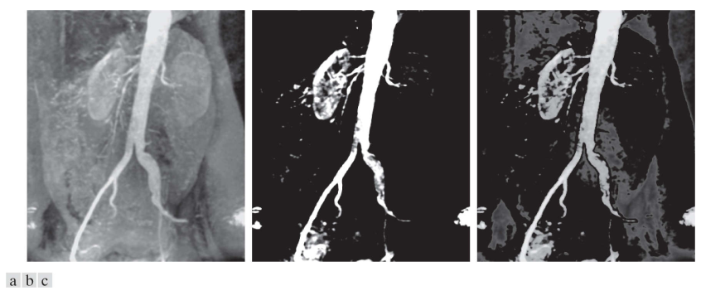
Intensity Level Slicing
Figure 16: (a) Aortic angiogram. (b) Result of using a slicing transformation with the range of intensities of interest selected in the upper end of the gray scale. (c) Result of using the transformation with the selected range set near black, so that the grays in the area of the blood vessels and kidneys were preserved.

Slide 48
Intensity Level Slicing
Figure 16 (b), The net result of this transformation is that the blood vessel and parts of the kidneys appear white, while all other intensities are black. This type of enhancement produces a binary image, and is useful for studying the shape characteristics of the flow of the contrast medium (to detect blockages, for example).
Figure 16 (c), shows the result of using such a transformation in which a band of intensities in the mid-gray region around the mean intensity was set to black, while all other intensities were left unchanged. Here, we see that the gray-level tonality of the major blood vessels and part of the kidney area were left intact. Such a result might be useful when interest lies in measuring the actual flow of the contrast medium as a function of time in a sequence of images.

Slide 49
Bit Plane Slicing
In bit plane slicing, we highlight the entire image appearance, which is specific to that particular bit plane. It is used in image reconstruction, compression, encryption etc.
Let’s consider a 8 bit image, here L=[0,1,2,3………255]
167 | 133 | 111
144 | 140 | 135
159 | 154 | 148
10100111 | 10000101 | 01101111
10010000 | 10001100 | 10000111
10011111 | 10011010 | 10010100

Slide 50
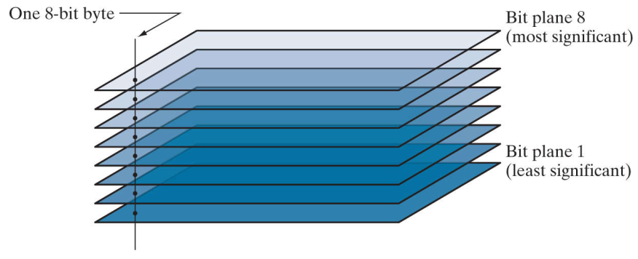
Bit Plane Slicing
Bit plane 1 represents least significant information and bit plane 8 represents most significant information.
Lower order bit planes 1,2,3,4,5 give least significant information and higher order bit planes 6,7,8 gives most significant information.
Here, using a particular bit plane, we can highlight the entire image appearance based on the specific bit plane.

Slide 51
Bit Plane Slicing
In Bit plane 1, which displays all pixels with bit 1 set: 00000001
In Bit plane 2, which displays all pixels with bit 2 set: 00000010
In Bit plane 3, which displays all pixels with bit 3 set: 00000100
In Bit plane 4, which displays all pixels with bit 4 set: 00001000
In Bit plane 5, which displays all pixels with bit 5 set: 00010000
In Bit plane 6, which displays all pixels with bit 6 set: 00100000
In Bit plane 7, which displays all pixels with bit 7 set: 01000000
In Bit plane 8, which displays all pixels with bit 8 set: 10000000

Slide 52
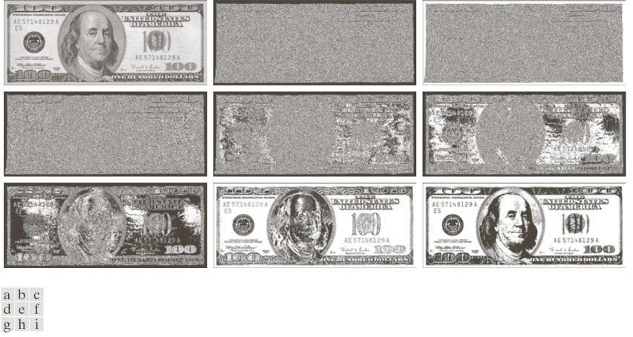
Bit Plane Slicing
Figure 17: (a) 8-bit gray scale image and (b)-(i) images are drawn into corresponding bit plane 1 to 8

Slide 53
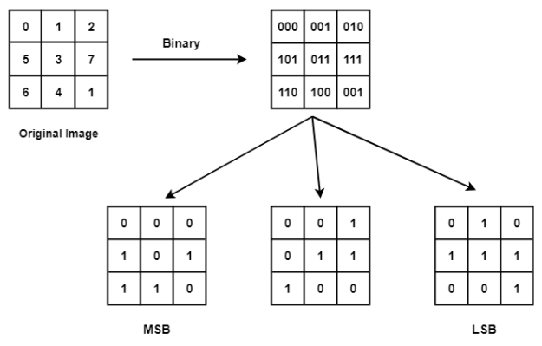
Bit Plane Slicing

Slide 54
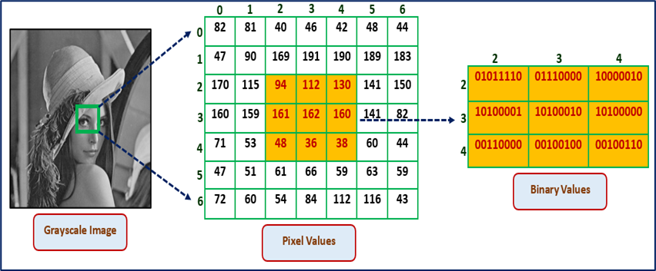
Bit Plane Slicing

Slide 55
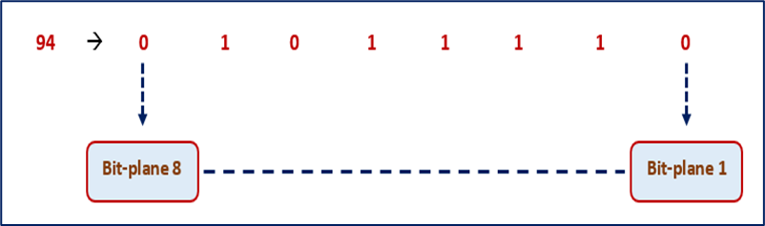
Bit Plane Slicing

Slide 56
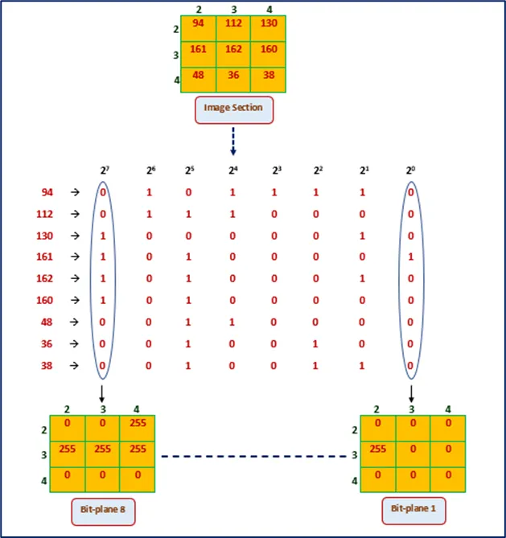
Bit Plane Slicing

Slide 57
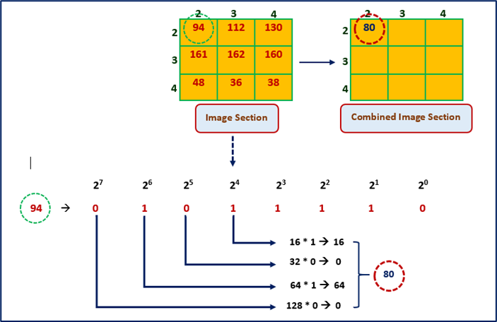
Bit Plane Slicing

Slide 58
Histogram Processing
Histogram can be defined as frequency of occurrence of each gray level in the image.
It is used in image enhancement, image compression and image segmentation etc.
Consider a gray level image, whose intensity values are ranges from [0 to L-1].
Histogram can be represented graphically as two types of plots:

Slide 59
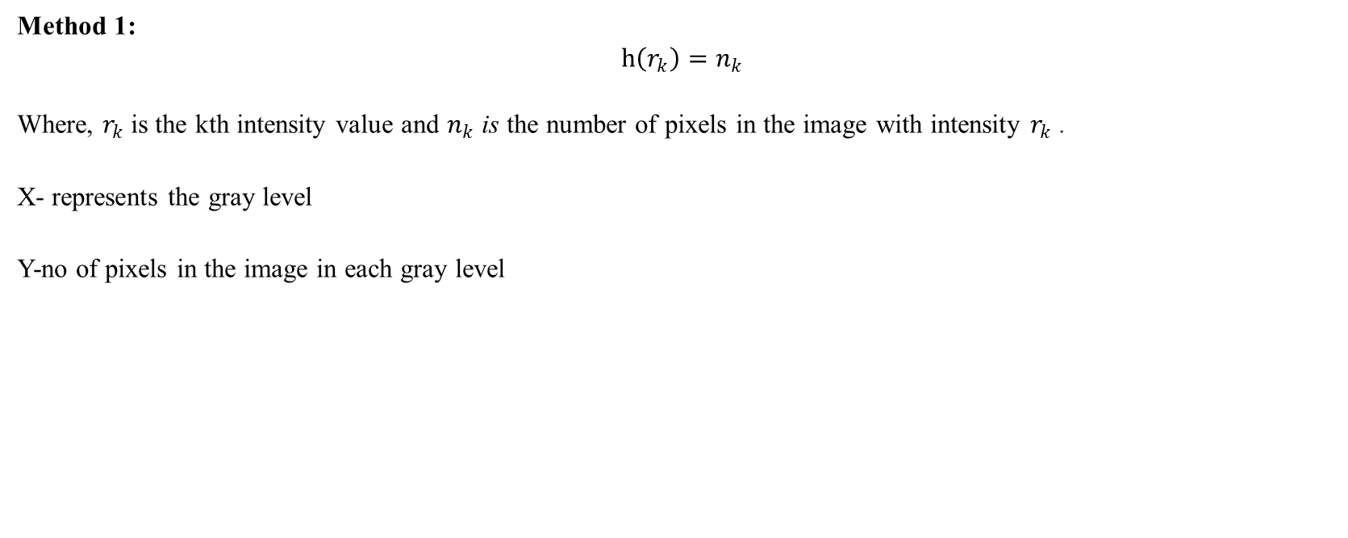
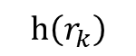
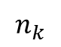
Histogram Processing
10 20 30 40
r
0 5 10 30 40 L-1

Slide 60
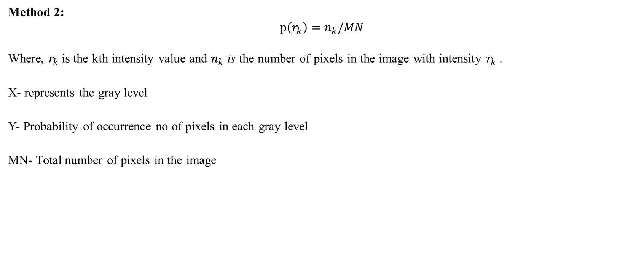
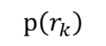
Histogram Processing
10 20 30 40
r
0 5 10 30 40 L-1

Slide 61
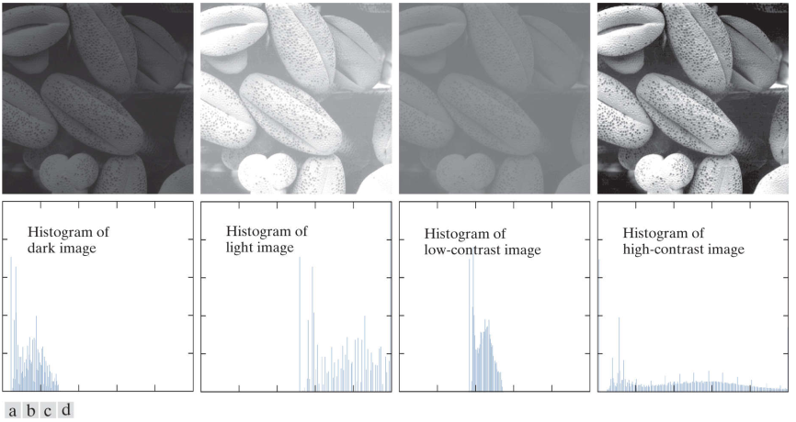
Histogram Processing
Figure 18: Four image types and their corresponding histograms. (a) dark; (b) light; (c) low contrast; (d) high contrast.

Slide 62
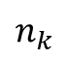
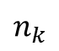
Histogram Equalization
A good quality or high contrast images will having a flattened or uniform histogram for entire intensity level ranging from 0 to L-1.
To obtain flattened or uniform histogram of an image we may go for histogram equalization.
0 L-1
Histogram Equalization
0 L-1
r
r
0 L-1
0 L-1

Slide 63
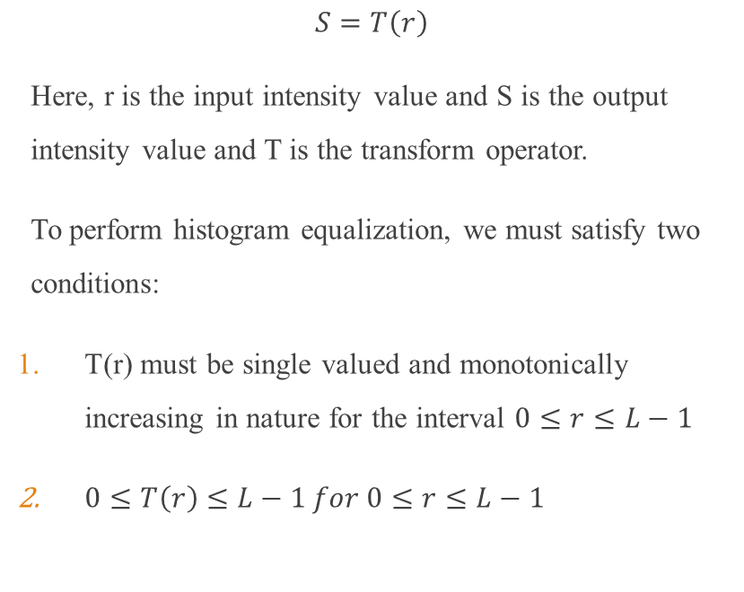
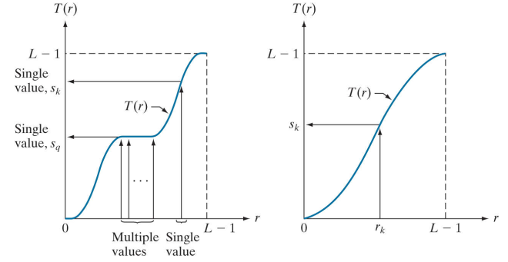
Histogram Equalization

Slide 64
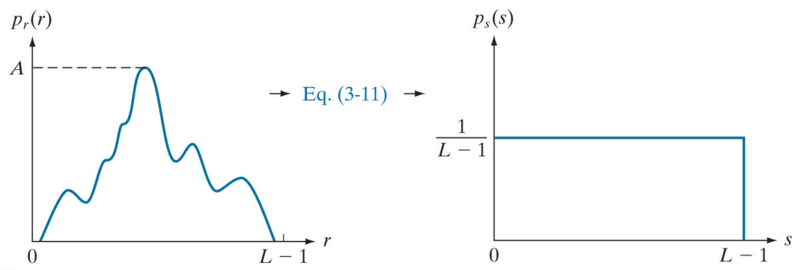

Histogram Equalization
Histogram Equalization
Figure 19: (a) continuous image (b) Histogram equalized image

Slide 65

Histogram Equalization
Here, ‘w’ is a dummy variable for integration.

Slide 66


Histogram Equalization
Now considering equation (2) and differentiating with respect to ‘r’ on both sides,

Slide 67

Histogram Equalization

Slide 68
Histogram Equalization
Histogram Equalization
Figure 19: (a) continuous image (b) Histogram equalized image

Slide 69

Histogram Equalization
Example: Suppose that the (continuous) intensity values in an image have the PDF,
$$p_{r}(r)=\left\{\begin{matrix}\frac{2r}{(L−1)^{2}} & 0≤r≤L−1 \\ 0 & \text{Otherwise} \end{matrix}\right.$$
Find the $p_{s}(s)$ where the transformation function is given
$$s=T(r)=(L−1)\int_{0}^{r}{ }p_{r}(w)dw$$

Slide 70

Histogram Equalization
Solution:
$$s=T(r)$$
$$\begin{aligned} \\ =(L−1)\int_{0}^{r}{ } p_{r}(w)dw\end{aligned}$$
$$=(L−1)\int_{0}^{r}{ } \frac{2w}{(L−1)^{2}}dw$$
$$=(L−1)×\frac{2}{(L−1)^{2}}\int_{0}^{r}{ } wdw$$
$$=\frac{2}{(L−1)}\int_{0}^{r}{ } wdw$$
= $\frac{r^{2}}{(L−1)}$
$\begin{matrix} & \\ & \\ & \\ & \\ & =\end{matrix}$

Slide 71

Histogram Equalization
Solution:
$$\begin{matrix}\frac{ds}{dr} & =\frac{d}{dr}\frac{r^{2}}{\left(L−1\right)} \\ & =\frac{1}{\left(L−1\right)}\frac{d}{dr}r^{2} \\ & =\frac{2r}{\left(L−1\right)} \\ \frac{dr}{ds} & =\frac{\left(L−1\right)}{2r}\end{matrix}$$

Slide 72

Histogram Equalization
Solution:
$$\begin{matrix} & \\ & \begin{aligned}\left.p_{s}(s\right)=p_{r}\left(r\right)∗\left|\frac{dr}{ds}\right| \\ =\frac{2r}{{(L−1)}^{2}}∗\left|\frac{\left(L−1\right)}{2r}\right|\end{aligned} \\ & =\frac{1}{\left(L−1\right)}\end{matrix}$$

Slide 73

Histogram Equalization
L – Number of possible intensity levels in the image

Slide 74

Histogram Equalization
The discrete form of the transformation is,
$s_{k}=T\left(r_{k}\right)=\left(L−1\right)\sum_{j=0}^{k}{ } p_{r}\left(r_{j}\right)$= $\frac{(L−1)}{MN}\sum_{j=0}^{k}{ } n_{j}\begin{matrix} & \\ & \end{matrix}$
Where, $k=0,1,2,…,L−1$
The transformation (mapping) $T\left(r_{k}\right)$ is called a histogram equalization or histogram linearization transformation.

Slide 75
Histogram Equalization
Example 01: Perform histogram equalization on a 3 bit image (L=8) of size 64 X 64 pixels. The intensity distribution of the image is given below:
 | 0 | 1 | 2 | 3 | 4 | 5 | 6 | 7
 | 790 | 1023 | 850 | 656 | 329 | 245 | 122 | 81

Slide 76

Histogram Equalization
Solution:
0 | 790 | 0.19 | 1.33 | 1 | 790/4096=0.19
1 | 1023 | 0.25 | 3.08 | 3 | 1023/4096=0.25
2 | 850 | 0.21 | 4.55 | 5 | 850/4096=0.21
3 | 656 | 0.16 | 5.67 | 6 | 656+329/4096=0.24
4 | 329 | 0.08 | 6.23 | 6 | 656+329/4096=0.24
5 | 245 | 0.06 | 6.65 | 7 | (245+122+81)/4096=0.10
6 | 122 | 0.03 | 6.86 | 7 | (245+122+81)/4096=0.10
7 | 81 | 0.02 | 7.00 | 7 | (245+122+81)/4096=0.10

Slide 77

Histogram Equalization

Slide 78


Histogram Equalization
Solution:
Solution:
Figure 20. Histogram equalization. (a) Original histogram (b) Transformation function. (c) Equalized histogram

Slide 79


Histogram Equalization
Figure 21: Histogram equalized image

Slide 80

Histogram Equalization
Figure 22. (a) Image from Phoenix Lander. (b) Result of histogram equalization. (c) Histogram of image (a). (d) Histogram of image (b).

Slide 81
Histogram Equalization
Example 02: Perform histogram equalization for an 8X8 image shown below.
 | 0 | 1 | 2 | 3 | 4 | 5 | 6 | 7
 | 9 | 8 | 11 | 4 | 10 | 15 | 4 | 3

Slide 82

Histogram Equalization
Solution:
 |  |  |  |  | Histogram Equalized Level
0 | 9 | 0.141 | 0.141 | 0.987 | 1
1 | 8 | 0.125 | 0.266 | 1.862 | 2
2 | 11 | 0.172 | 0.438 | 3.066 | 3
3 | 4 | 0.0625 | 0.5005 | 3.5035 | 4
4 | 10 | 0.156 | 0.6565 | 4.5955 | 5
5 | 15 | 0.234 | 0.8905 | 6.2335 | 6
6 | 4 | 0.0625 | 0.953 | 6.671 | 7
7 | 3 | 0.047 | 1 | 7 | 7
Gray Levels | 1 | 2 | 3 | 4 | 5 | 6 | 7
No. of pixels | 9 | 8 | 11 | 4 | 10 | 15 | 7

Slide 83
Histogram Equalization
Example 03: Perform histogram equalization for the following 5x5 image given below.
Solution: Here, maximum pixel value = 5, so there are 8 levels and (L-1) = (8-1) = 7
1 | 2 | 1 | 1 | 1
2 | 5 | 3 | 5 | 2
2 | 5 | 5 | 5 | 2
2 | 5 | 3 | 5 | 2
1 | 5 | 1 | 2 | 1
 | 0 | 1 | 2 | 3 | 4 | 5 | 6 | 7
 | 0 | 8 | 8 | 2 | 0 | 7 | 0 | 0

Slide 84

Histogram Equalization
Solution:
 |  |  |  |  | Histogram Equalized Level
0 | 0 | 0 | 0 | 0 | 0
1 | 8 | 0.32 | 0.32 | 2.24 | 2
2 | 8 | 0.32 | 0.64 | 4.48 | 4
3 | 2 | 0.08 | 0.72 | 5.04 | 5
4 | 0 | 0 | 0.72 | 5.04 | 5
5 | 7 | 0.28 | 1 | 7 | 7
6 | 0 | 0 | 1 | 7 | 7
7 | 0 | 0 | 1 | 7 | 7
Gray Levels | 0 | 2 | 4 | 5 | 7
No. of pixels | 0 | 8 | 8 | 2 | 7

Slide 85
Histogram Equalization
Solution:
Input Image
Output Image
1 | 2 | 1 | 1 | 1
2 | 5 | 3 | 5 | 2
2 | 5 | 5 | 5 | 2
2 | 5 | 3 | 5 | 2
1 | 5 | 1 | 2 | 1
2 | 4 | 2 | 2 | 2
4 | 7 | 5 | 7 | 4
4 | 7 | 7 | 7 | 4
4 | 7 | 5 | 7 | 4
2 | 2 | 2 | 4 | 2

Slide 86
Histogram Matching (Specification)
Histogram equalization works for the entire image pixel values. Therefore, it is not a best approach for some applications.
Let’s consider, if we wish to enhance the specific region of an image then histogram equalization fails.
That’s why we will go for a new approach called histogram matching or histogram specification.
The method used to generate a processed image that has a specified histogram is called histogram matching or histogram specification.
In another way, histogram specification method develops a gray level transformation such that the histogram of the output image matches that of the pre-specified histogram of a target image.
The goal of histogram matching is to take an input image and generate an output image based upon a specific histogram or reference histogram.

Slide 87


Histogram Matching (Specification)
Figure 23: Histogram Matching

Slide 88
Histogram Matching (Specification)
Mapping function can be found in three steps:
Equalize the histogram of the input image.
Equalize the specified histogram.
Relate the two equalized histograms.
For example, suppose the pixel value 10 in the original image gets mapped to 20 in the equalized image. Then we will see what value in Specified image gets mapped to 20 in the equalized image and let’s say that this value is 28. So, we can say that 10 in the original image gets mapped to 28 in the specified image.

Slide 89

Histogram Specification
z

Slide 90

Histogram Specification

Slide 91

Histogram Matching (Specification)
Problem01: Assuming continuous intensity values, suppose that an image has the intensity PDF,
$$p_{r}(r)=\left\{\begin{matrix}\frac{2r}{(L−1)^{2}} & 0≤r≤L−1 \\ 0 & \text{Otherwise} \end{matrix}\right.$$
Find the transformation function that will produce an image whose intensity PDF is
$$p_{z}(z)=\left\{\begin{matrix}\frac{3z^{2}}{(L−1)^{3}} & 0≤z≤L−1 \\ 0 & \text{Otherwise} \end{matrix}\right.$$

Slide 92

Histogram Matching (Specification)
Solution 01: First, we find the histogram equalization transformation for the interval $[0$, L-1]
$$s=T\left(r\right)\begin{aligned} \\ =\left(L−1\right)\int_{0}^{r}{ } p_{r}\left(w\right)dw\end{aligned}$$
$$=\left(L−1\right)\int_{0}^{r}{ } \frac{2w}{(L−1)^{2}}dw$$
$$=\left(L−1\right)×\frac{2}{(L−1)^{2}}\int_{0}^{r}{ } wdw$$
$$=\frac{2}{(L−1)}\int_{0}^{r}{ } wdw$$
$$=\frac{r^{2}}{(L−1)}$$
By definition, this transformation is 0 for values outside the range $[0,L$-1].

Slide 93

Histogram Matching (Specification)
Solution 01: We are interested in an image with a specified histogram, so we find next,
$$G\left(z\right)=\left(L−1\right)\int_{0}^{z}{ } p_{z}\left(t\right)dt$$
$$=(L−1)\int_{0}^{z}{ } \frac{3t^{2}}{(L−1)^{3}}dt$$
$$=(L−1)\int_{0}^{z}{ } \frac{3t^{2}}{(L−1)^{3}}dt$$
$$=\frac{3}{(L−1)^{2}}\int_{0}^{z}{ } t^{2}dt$$
$$=\frac{3}{(L−1)^{2}}\int_{0}^{z}{ } t^{2}dt$$
over the interval $[0, L−1]$.

Slide 94



Histogram Matching (Specification)
Solution01:
Finally, we require that $s=G(z)$
$$s=\frac{z^{3}}{(L−1)^{2}}$$
$$s=\frac{z^{3}}{(L−1)^{2}}$$
Two steps of mapping: r to s then s to z, therefore, r maps to z.
r----s----z
We have, $s=\frac{r^{2}}{(L−1)}$
$$\begin{matrix}z & ={\left[{(L−1)}^{2}∗\frac{r^{2}}{(L−1)}\right]}^{\frac{1}{3}} \\ & ={\left[\left(L−1)r^{2}\right.\right]}^{\frac{1}{3}}\end{matrix}$$

Slide 95

Histogram Matching(Specification)

Slide 96

Histogram Matching(Specification)
hhh

Slide 97
Histogram Matching(Specification)
Example-01: Perform histogram matching or specification for the following image:
Original image
Target image
Gray levels | 0 | 1 | 2 | 3 | 4 | 5 | 6 | 7
No. of pixels | 8 | 10 | 10 | 2 | 12 | 16 | 4 | 2
Gray levels | 0 | 1 | 2 | 3 | 4 | 5 | 6 | 7
No. of pixels | 0 | 0 | 0 | 0 | 20 | 20 | 16 | 8

Slide 98

Histogram Matching(Specification)
Solution-01: Histogram Equalization (Original image)
Gray Levels | No of pixels | PDF | CDF | (L-1)*CDF | $$S_{K}$$
0 | 8 | 0.13 | 0.13 | 0.91 | 1
1 | 10 | 0.16 | 0.29 | 2.03 | 2
2 | 10 | 0.16 | 0.45 | 3.15 | 3
3 | 2 | 0.03 | 0.48 | 3.36 | 3
4 | 12 | 0.18 | 0.66 | 4.62 | 5
5 | 16 | 0.25 | 0.91 | 6.37 | 6
6 | 4 | 0.06 | 0.97 | 6.79 | 7
7 | 2 | 0.03 | 1.0 | 7 | 7

Slide 99

Histogram Matching(Specification)
Histogram Equalization (Target image)
Gray Levels | No of pixels | PDF | CDF | (L-1)*CDF | $$S_{K}$$
0 | 0 | 0 | 0 | 0 | 0
1 | 0 | 0 | 0 | 0 | 0
2 | 0 | 0 | 0 | 0 | 0
3 | 0 | 0 | 0 | 0 | 0
4 | 20 | 0.31 | 0.31 | 2.17 | 2
5 | 20 | 0.31 | 0.62 | 4.34 | 4
6 | 16 | 0.25 | 0.87 | 6.09 | 6
7 | 8 | 0.13 | 1.0 | 7 | 7

Slide 100

Histogram Matching(Specification)
Mapping of Histogram Specified Pixels
Pick one by one the values from the round column of the original image, find it in the round column of the specified image and note down the index. For example for 3 in the round original, we have 3 in the round specified column (with index 1) so we map it to 1.
If the value doesn’t exist then find the index of its nearest one. For example for 0 in round original, 1 is the nearest in round specified column (with index 0) so we map it to 0.
If multiple nearest values exist then pick the one which is greater than the value. For example for 2 in the round original, there are 2 closest values in round specified i.e. 1 and 3 so we pick 3 (with index 1) so we map it to 1.
Gray levels | $S_{K}$(Original) | $S_{K}$(Target) | Mapped Pixels
0 | 1 | 0 | 4
1 | 2 | 0 | 4
2 | 3 | 0 | 5
3 | 3 | 0 | 5
4 | 5 | 2 | 6
5 | 6 | 4 | 6
6 | 7 | 6 | 7
7 | 7 | 7 | 7
Output Image
Gray levels | 0 | 1 | 2 | 3 | 4 | 5 | 6 | 7
No. of pixels | 0 | 0 | 0 | 0 | 18 | 12 | 28 | 6

Slide 101
Histogram Matching(Specification)
Example-02: Perform histogram matching or specification for the following image:
Original image
Target image
Gray levels | 0 | 1 | 2 | 3 | 4 | 5 | 6 | 7
No. of pixels | 2 | 3 | 5 | 6 | 9 | 12 | 14 | 13
Gray levels | 0 | 1 | 2 | 3 | 4 | 5 | 6 | 7
No. of pixels | 13 | 12 | 14 | 14 | 11 | 0 | 0 | 0

Slide 102

Histogram Matching(Specification)
Solution-02: Histogram Equalization (Original image)
Gray Levels | No of pixels | PDF | (L-1)*CDF | $$S_{K}$$
0 | 2 | 0.03 | 0.21 | 0
1 | 3 | 0.05 | 0.56 | 1
2 | 5 | 0.08 | 1.12 | 1
3 | 6 | 0.09 | 1.75 | 2
4 | 9 | 0.14 | 2.73 | 3
5 | 12 | 0.19 | 4.06 | 4
6 | 14 | 0.22 | 5.60 | 6
7 | 13 | 0.20 | 7.00 | 7

Slide 103

Histogram Matching(Specification)
Histogram Equalization (Target image)
Gray Levels | No of pixels | PDF | (L-1)*CDF | $$S_{K}$$
0 | 0 | 0.20 | 1.40 | 1
1 | 0 | 0.19 | 2.73 | 3
2 | 0 | 0.22 | 4.27 | 4
3 | 0 | 0.22 | 5.81 | 6
4 | 20 | 0.17 | 7 | 7
5 | 20 | 0 | 7 | 7
6 | 16 | 0 | 7 | 7
7 | 8 | 0 | 7 | 7

Slide 104

Histogram Matching(Specification)
Mapping of Histogram Specified Pixels
Gray levels | $S_{K}$(Original) | $S_{K}$(Target) | Mapped Pixels
0 | 0 | 1 | 0
1 | 1 | 3 | 0
2 | 1 | 4 | 0
3 | 2 | 6 | 1
4 | 3 | 7 | 1
5 | 4 | 7 | 2
6 | 6 | 7 | 3
7 | 7 | 7 | 4
Output Image
Gray levels | 0 | 1 | 2 | 3 | 4 | 5 | 6 | 7
No. of pixels | 10 | 15 | 12 | 14 | 13 | 0 | 0 | 0

Slide 105

Histogram Matching(Specification)
Problem-03: Perform histogram matching for a 3 bit image of size 64X64 using the following data:
Input image
Specified Histogram
0 | 790 | 0.19 | 1.33 | 1 | 0.19
1 | 1023 | 0.25 | 3.08 | 3 | 0.25
2 | 850 | 0.21 | 4.55 | 5 | 0.21
3 | 656 | 0.16 | 5.67 | 6 | 0.24
4 | 329 | 0.08 | 6.23 | 6 | 0.24
5 | 245 | 0.06 | 6.65 | 7 | 0.109
6 | 122 | 0.03 | 6.86 | 7 | 0.109
7 | 81 | 0.02 | 7.00 | 7 | 0.109
0 | 0.00
1 | 0.00
2 | 0.00
3 | 0.15
4 | 0.20
5 | 0.30
6 | 0.20
7 | 0.15

Slide 106


Histogram Matching(Specification)
0 | 0
1 | 0
2 | 0
3 | 1
4 | 2
5 | 5
6 | 6
7 | 7

Slide 107

Histogram Matching(Specification)
Gray Levels | $S_{K}$ (Original) | $S_{K}$ (Target) | Mapped Pixel ($Z_{K}$)
0 | 1 | 0 | 3
1 | 3 | 0 | 4
2 | 5 | 0 | 5
3 | 6 | 1 | 6
4 | 6 | 2 | 6
5 | 7 | 5 | 7
6 | 7 | 6 | 7
7 | 7 | 7 | 7
Output Image
Gray levels | 0 | 1 | 2 | 3 | 4 | 5 | 6 | 7
No. of pixels | 0 | 0 | 0 | 790 | 1023 | 850 | 985 | 448

Slide 108

Histogram Matching(Specification)
0 | 790 | 0.19 | 1.33 | 1 | 0.19
1 | 1023 | 0.25 | 3.08 | 3 | 0.25
2 | 850 | 0.21 | 4.55 | 5 | 0.21
3 | 656 | 0.16 | 5.67 | 6 | 0.24
4 | 329 | 0.08 | 6.23 | 6 | 0.24
5 | 245 | 0.06 | 6.65 | 7 | 0.109
6 | 122 | 0.03 | 6.86 | 7 | 0.109
7 | 81 | 0.02 | 7.00 | 7 | 0.109
0 | 0.00 | 0
1 | 0.00 | 0
2 | 0.00 | 0
3 | 0.15 | 0.19
4 | 0.20 | 0.25
5 | 0.30 | 0.21
6 | 0.20 | 0.24
7 | 0.15 | 0.109

Slide 109

Comparison Between Histogram Equalization and Specification
Figure 23. (a) An image (b) Histogram of the image (a)

Slide 110


Comparison Between Histogram Equalization and Specification
Figure 24. (a) Histogram equalization transformation obtained using the histogram in Fig 23 (b). (b) Histogram equalized image. (c)
Histogram of equalized image.

Slide 111


Comparison Between Histogram Equalization and Specification
The transformation function G(z) obtained from this histogram is labeled transformation (1) in Fig. 25(b).
Similarly, the inverse transformation from is labeled transformation (2).
The enhanced image in Fig. 25(c) was obtained by applying transformation (2) to the pixels of the histogram-equalized image in Fig. 24(b).

Slide 112
Local Histogram Processing
The histogram processing methods discussed thus far are global, in the sense that pixels are modified by a transformation function based on the intensity distribution of an entire image.
This global approach is suitable for overall enhancement, but generally fails when the objective is to enhance details over small areas in an image.
This is because the number of pixels in small areas have negligible influence on the computation of global transformations.

Slide 113
Local Histogram Processing
The solution is to devise transformation functions based on the intensity distribution of pixel neighborhoods.
In histogram equalization and specification we are actually applying the transformation function on the entire image.
But, in local histogram processing we are applying the transformation function on the neighborhood of the pixels.

Slide 114
Local Histogram Processing
The histogram processing techniques previously described can be adapted to local enhancement.
The procedure is to define a neighborhood and move its center from pixel to pixel in a horizontal or vertical direction.
At each location, the histogram of the points in the neighborhood is computed, and either a histogram equalization or histogram specification transformation function is obtained.
This function is used to map the intensity of the pixel centered in the neighborhood. The center of the neighborhood is then moved to an adjacent pixel location and the procedure is repeated.

Slide 115
Local Histogram Processing
Because only one row or column of the neighborhood changes in a one-pixel translation of the neighborhood, updating the histogram obtained in the previous location with the new data introduced at each motion step is possible.
This approach has obvious advantages over repeatedly computing the histogram of all pixels in the neighborhood region each time the region is moved one pixel location.
Another approach used sometimes to reduce computation is to utilize nonoverlapping regions, but this method usually produces an undesirable “blocky” effect.

Slide 116

Local Histogram Processing
Figure 26: (a) Original image. (b) Result of global histogram equalization. (c) Result of local histogram equalization.

Slide 117
Local Histogram Processing
Figure 26(a) is an 8-bit, 512X512 image consisting of five black squares on a light gray background.
The image is slightly noisy, but the noise is imperceptible. There are objects embedded in the dark squares, but they are invisible for all practical purposes.
Figure 26(b) is the result of global histogram equalization. As is often the case with histogram equalization of smooth, noisy regions, this image shows significant enhancement of the noise.
However, other than the noise, Fig. 26(b) does not reveal any new significant details from the original.
Figure 26(c) was obtained using local histogram equalization of Fig. 26(a) with a neighborhood of size of 3X3. Here, we see significant detail within all the dark squares.

Slide 118

Using Histogram Statistics for Image Enhancement

Slide 119

Using Histogram Statistics for Image Enhancement

Slide 120

Using Histogram Statistics for Image Enhancement
0 | 0 | 1 | 1 | 2
1 | 2 | 3 | 0 | 1
3 | 3 | 2 | 2 | 0
2 | 3 | 1 | 0 | 0
1 | 1 | 3 | 2 | 2

Slide 121

Using Histogram Statistics for Image Enhancement

Slide 122
Thank You ☺

